Slide 1
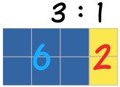
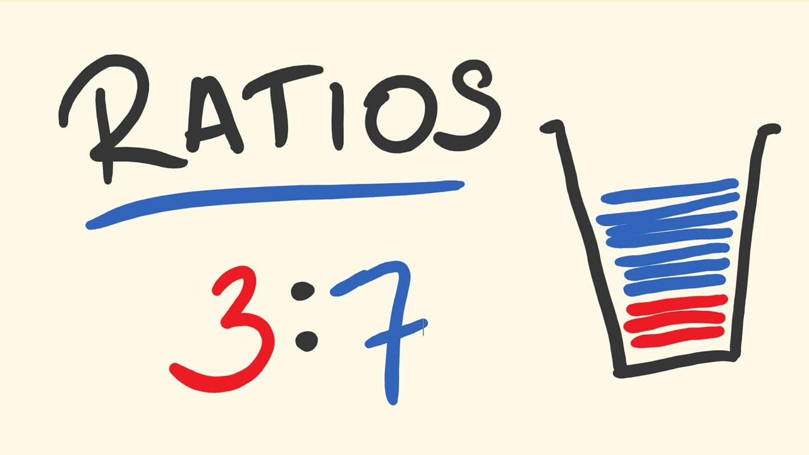
My Proportion Interactive Notebook
Name:
Class:
Teacher:
Term 2 Semester 1

Slide 2
https://mathantics.com/section/lesson-video/ratios-and-rates

Slide 3
24
7
30
Date
Ratio
EQ – What is a ratio and how is it used?
What is a ratio?
Ratios are used to compare quantities with the same units.
The ratio of 2 to 5 is written as 2 : 5
How is a ratio used?
If you are making cordial and you mix one part cordial to four parts water, then the ratio of cordial to water will be 1:4 (1 to 4).
If you use 1L of cordial, you will use 4L of water (1:4).
If you use 2L of cordial, you will use 8L of water (2:8).
If you use 10L of cordial, you will use 40L of water (10:40).
These ratios are all equivalent 1:4 = 2:8 = 10:40
Simplifying ratios is the same as simplifying fractions!

Slide 4
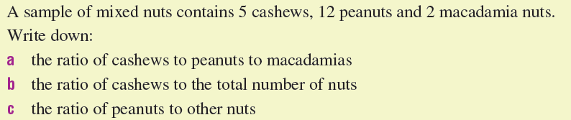
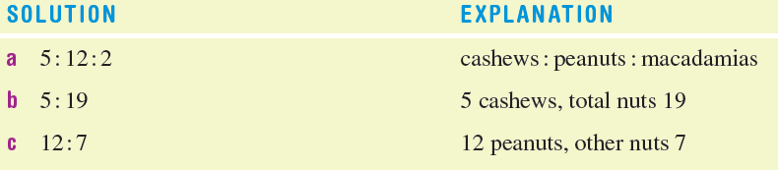
For example…

Slide 5

Do you understand? Fists of Five
Notes:
Check for Understanding

Slide 6
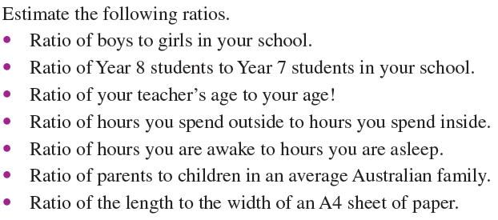

Let’s have a try together
Don’t forget to simplify!!!

Slide 7
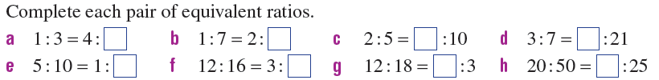
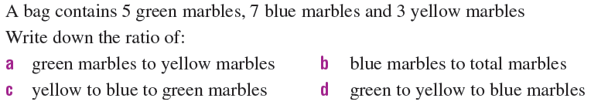
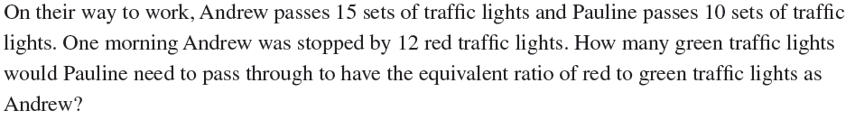
Now you have a go
1.
2.
3.
4.

Slide 8

Have YOU been doing your summaries?

Slide 9
Notes Review
24, 7 ,30
Date
Title
Essential question
Notes complete
Notes complete with colour and diagrams
Questions completed
Contents page filed in
Formula page filled in

Slide 10
Homework
Review your notes and write a summary answering the essential question.

